Slide 1
UAV Medical Supplies Delivery System
Technical Seminar
Yagna Srinivasa Harsha Annadata
YXA210024
Eedg 6302: Microprocessor & embedded Systems

Slide 2
Table of Contents
Introduction
UAV as a Medical Supplies Delivery System
Pros/Cons
Conclusion
References
Q & A

Slide 3
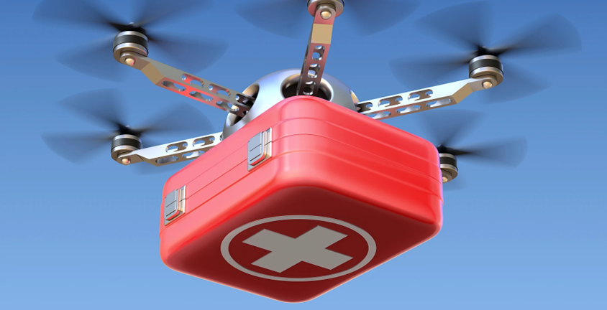
Introduction
Transport of medical supplies to home
Safe and secure transport without ruining the quality of the medicines
Easy and quick access

Slide 4
UAV as a Medical Supplies Delivery System
The seminar mainly focus on the Embedded System used in the Medical Supplies Delivery System.
How is the UAV built using the Embedded System?
Proposed Model
How UAV is useful?

Slide 5
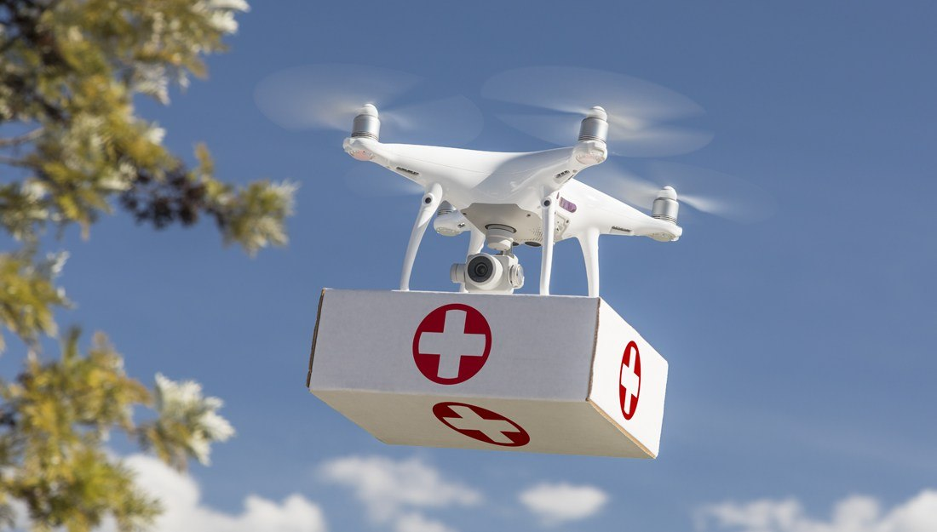
BUILDING AN UAV
Flight Controller
Camera and Video Transmission Module (VTM)
Data Transmission Module (DTM)
Electronic Speed Controller (ESC)
Global Positioning System (GPS)
Brushless Motors.
Battery
Transmitter and Receiver
Peltier Module

Slide 6
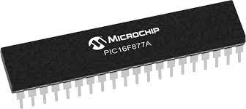
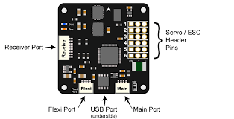
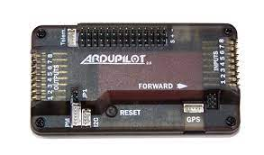
Flight Controller
PIC 16FB77A
CC3D Flight Controller
ArdupilotMega (APM)

Slide 7
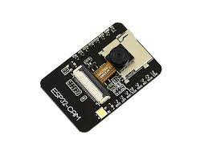
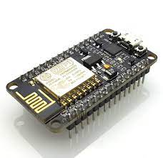
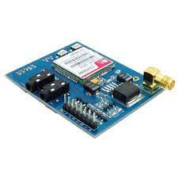
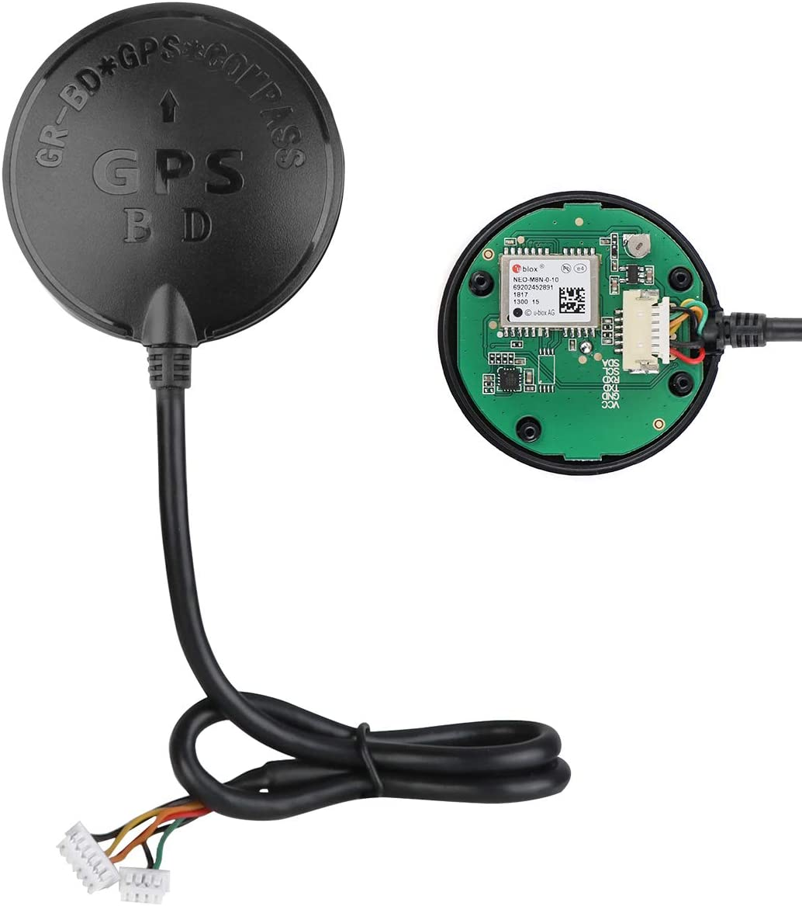
Other Design Specs
VTM: ESP32-cam
DTM: ESP8266 Nodemcu/Sim900 GSM module
GPS: NEO-M8N BDS

Slide 8
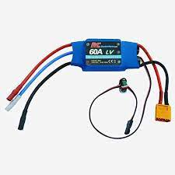
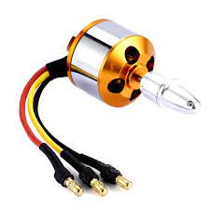
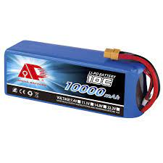
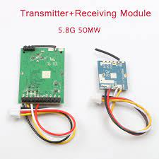
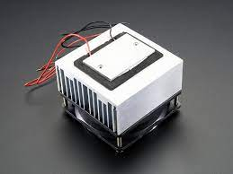
Other Design Specs
ESC
Brushless Motors
Battery
Transmitter and Receiver
Peltier Module

Slide 9
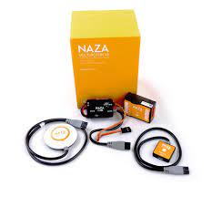
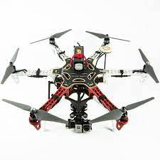
Proposed Model
DJI NAZA-M V2 kit
Hexa Copter kit
Medical Box

Slide 10
PROS/CONS
PROS:
Faster than the regular transport system
It is very feasible
Can be used in emergency situations
CONS:
Environmental issues
Mechanical and functionality issues

Slide 11
Conclusion
It is way faster and efficient than the regular method
This product is helpful in providing necessary medicines in areas which are not fit for traditional transportation methods
crucial applications comes in emergency situations

Slide 12
References
“Medical Drones System for Amusement Parks”
IEEE Xplore, https://ieeexplore.ieee.org/document/8308255
“Multi-Purpose Medical Drone for the Use in Pandemic Situation”
IEEE Xplore, https://ieeexplore.ieee.org/document/9607300
“Medical Drone – A Life Saver in Emergency Situations”
Research Gate, https://www.researchgate.net/publication/325686036_Medical_Drone_- _A_Life_Saver_in_Emergency_Situations
“Medicine Delivery Drone”
Research Gate, https://www.researchgate.net/publication/343694959_Medicine_Delivery_Drone

Slide 13
Thank you
Yagna Srinivasa Harsha Annadata
YXA210024
yxa210024@utdallas.edu

